Slide 1
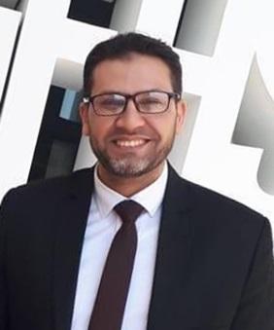
Image Stitching
1
Presented by
George Zaky Raouf Code: 180045
Khalid Ali Mohamed Code: 180053
Beshoy William Boshra Code: 180041
Basel Adnan Ahmed Code: 180038
Supervised by
Dr. Ahmed Elngar
Faculty of Computers and Artificial Intelligence
Beni-Suef University
Computer Vision: Image Stitching. Sunday 28 -11-2021

Slide 2
Outline
DEFINITIONS
APPLICATIONS
IMAGE STITCHING APPROACHES
THE MAIN COMPOENTS OF IMAGE STITCHING
FEATURES BASED TECHNIQUE ALGORITHM
CODE AND RUN

Slide 3



Definitions
Image stitching or photo stitching is the process of combining multiple photographic images with overlapping fields of view to produce a segmented panorama or high-resolution image. Commonly performed through the use of computer software.
It enables the combination of multiple shots to create a large-scale picture that is beyond the normal aspect ratio of the camera’s individual shots.

Slide 4
Applications
Image stitching is widely used in modern applications such as:
• Document mosaicing
• Image stabilization feature in camcorders that use frame-rate image alignment.
• digital maps and satellite imagery
• Medical imaging
• Multiple-image super-resolution imaging
• Video stitching
• Object insertion

Slide 5
Image Stitching Approaches
The direct and feature based techniques are considered as the main approaches for image stitching.
The direct techniques work by directly minimizing pixel to pixel dissimilarities.
The feature based techniques work by extracting a sparse set of features and then matching these to each other

Slide 6
Image Stitching Approaches
Direct Techniques
The direct technique utilizes all the image pixels of the image and comparing all the pixel intensities of the images with each other. It minimize the sum of absolute differences between overlapping pixels or use any other available cost functions.
Advantages | Disadvantages
they make optimal use of the information available in image alignment. They measure the contribution of every pixel in the image. | computationally complex. not invariant to image scale and rotation. they have a limited range of convergence It also performs very slowly and makes it undesirable for real time applications it is greatly affected by exposure differences.

Slide 7
Image Stitching Approaches
Feature based Techniques
This approach work through compare all features in one image against all features in the other using one of the local descriptors. Unfortunately, this is quadratic in the expected number of features, which makes it impractical for some applications.
Feature based methods begin by establishing correspondences between points, lines, edges, corners, or other geometric entities. Characteristics of robust detectors include invariance to image noise, scale invariance, translation invariance, and rotation transformations.

Slide 8
The MAIN COMPOENTS OF
IMAGE STITCHING
Image stitching process is divided into three main components:
Calibration.
Registration.
Blending.
The goal of image calibration aims to minimize differences between an ideal lens models and the camera-lens combination that was used. During the image registration, multi-images are compared to find the translations that can be used for the alignment of images. After registration, these images are blended together to form a single image.

Slide 9
Cont.
Calibration:
aims to minimize differences between an ideal lens models and the camera-lens combination that was used, optical defects such as:
Distortions.
Exposure differences between images.
Vignetting.
Camera response.
Chromatic aberrations.

Slide 10
Cont.
Registration:
Involves feature matching
Simple solution is using direct alignment methods to search for image alignments that minimize the sum of absolute differences between overlapping pixels.
A more robust solution uses a common method known as RANSAC
The basic assumption of the method is that the data consists of inliers (fits the model) and outliers (doesn’t fit the model)
if the ratio of number of outliers to data points is very low, the RANSAC outputs a decent model fitting the data.

Slide 11
Cont.
Blending:
Colors are adjusted between images to compensate for exposure differences. Images are blended together and seam line adjustment is done to minimize the visibility of seams between images
There are 2 popular methods:
Alpha Blending which takes weighted average of two images.
Gaussian pyramid merges the images at different frequency bands and filters them accordingly. (blurs the boundary while preserving the pixels away from the boundary)

Slide 12
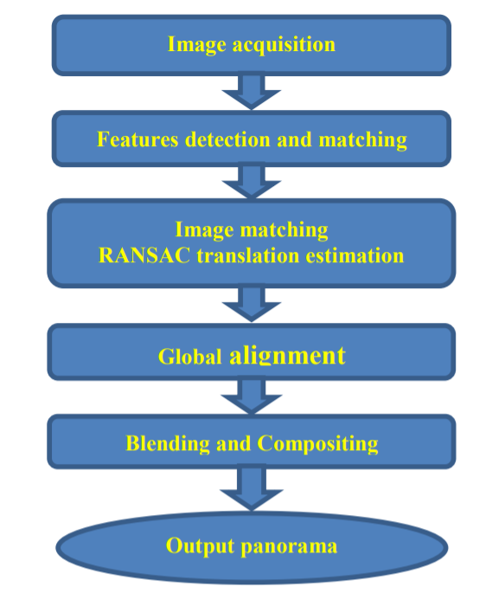
FEATURES BASED TECHNIQUE ALGORITHM

Slide 13
Cont.
Image acquisition:
The first stage of any vision system is the image acquisition stage. Image acquisition can be broadly defined as the action of retrieving an image from some sources.

Slide 14
Cont.
Features detection and matching :
Features can be defined as the elements in the two or more input images to be matched.
It relies on the idea that instead of looking at the image as a whole, it could be better to select some special points “key points” in the image and perform a local analysis on these ones.
SIFT and SURF are recent key-point or interest point detector algorithms

Slide 15
Cont.
Homography Using RANSAC
In image matching step, we are going to find out which picture is a neighbor of another picture, and find the correctly feature matching set we need for next step of all feature matching.
RANSAC loop involves selecting four feature pairs (at random); compute Homography H (exact); compute inliers, keep largest set of inliers, and finally it re-compute least squares H estimate on all of the inliers.

Slide 16
Cont..
Global Alignment The most relevant technique is bundle adjustment, which is a photogrammetric technique to combine multiple images of the same scene into an accurate 3D reconstruction. The aim of this step is to find a globally consistent set of alignment parameters that minimize the mis-registration between all pairs of images. Initial estimates of the 3D location of features in the scene must first be computed, as well as estimates of the camera locations.

Slide 17
Cont..
Then, bundle adjustment applies an iterative algorithm to compute optimal values for the 3D reconstruction of the scene and camera positions, by minimizing the log-likelihood of the overall feature projection errors using a least-squares algorithm. In order to do this, we need to extend the pairwise matching criteria to a global energy function that involves all of the perimage pose parameters. Once we have computed the global alignment, we need to perform local adjustments such as parallax removal to reduce double images and blurring due to local mis-registration.

Slide 18
Cont..
Compositing Once we have registered all of the input images with respect to each other, we need to decide how to produce the final stitched (mosaic) image. This involves selecting a final compositing surface, e.g., flat, cylindrical. Finally, we must decide how to blend them in order to create an attractive looking panorama. The first step to be made is how to represent the final image. If only a few images are stitched together, a natural approach is to select one of the images as the reference and to then warp all of the other images into the reference coordinate system.

Slide 19
Cont..
The resulting composite is sometimes called a flat panorama. Since the projection onto the final surface is still a perspective projection, hence straight lines remain straight (which is often a desirable attribute). There are many different projective layouts on which image mosaicing can be used, such as rectilinear projection, where the stitched image is viewed on a two-dimensional plane intersecting the panosphere in a single point. Lines that are straight in reality are shown as straight regardless of their directions on the image. Wide views - around 120° or so - start to exhibit severe distortion near the image borders.

Slide 20
Cont..
One case of rectilinear projection is the use of cube faces with cubic mapping for panorama viewing. Panorama is mapped to six squares. Each cube face showing 90 by 90 degree area of the panorama. It also shows the cylindrical projection where the stitched image shows a 360° horizontal field of view and a limited vertical field of view. Panoramas in this projection are meant to be viewed as though the image is wrapped into a cylinder and viewed from within.

Slide 21
Cont..
Conclusion Image mosaicing is considered as an active research area in the fields of computer vision and computer graphics. It has a large amount of different algorithms for features detection and description. The choice of the feature detector depends on the problem. In this paper, we have offered a comprehensive study on features-based image stitching such as the ORB algorithm is rotation and scale invariant with improved execution time but its performance is poor in presence of noise.

Slide 22
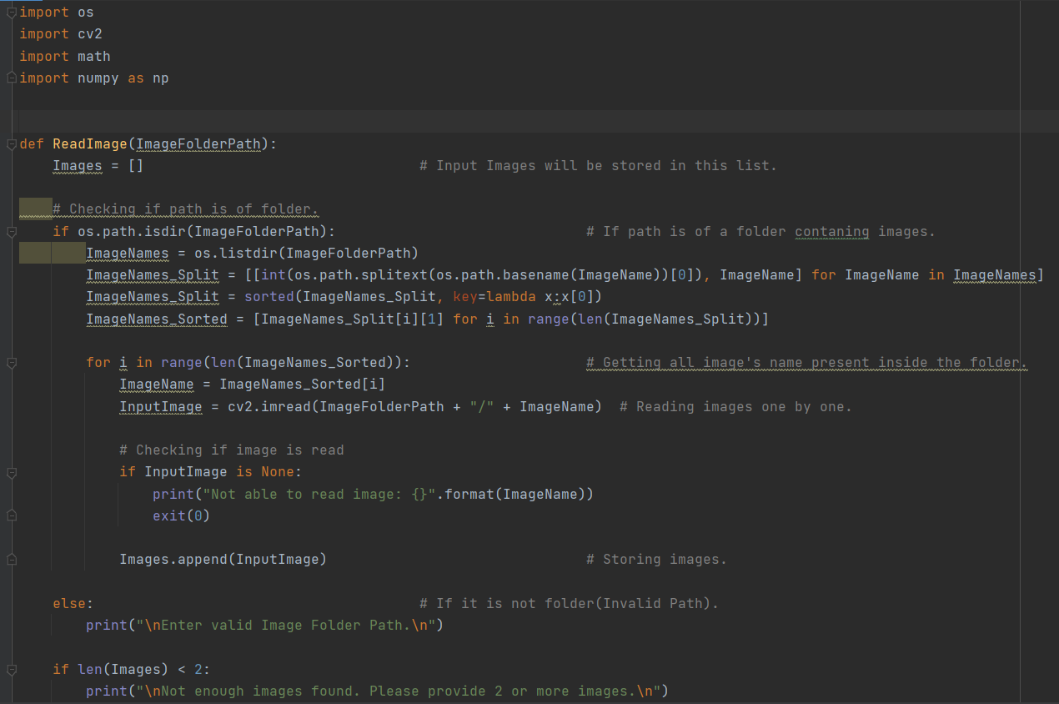
Cont..
Code & Run

Slide 23
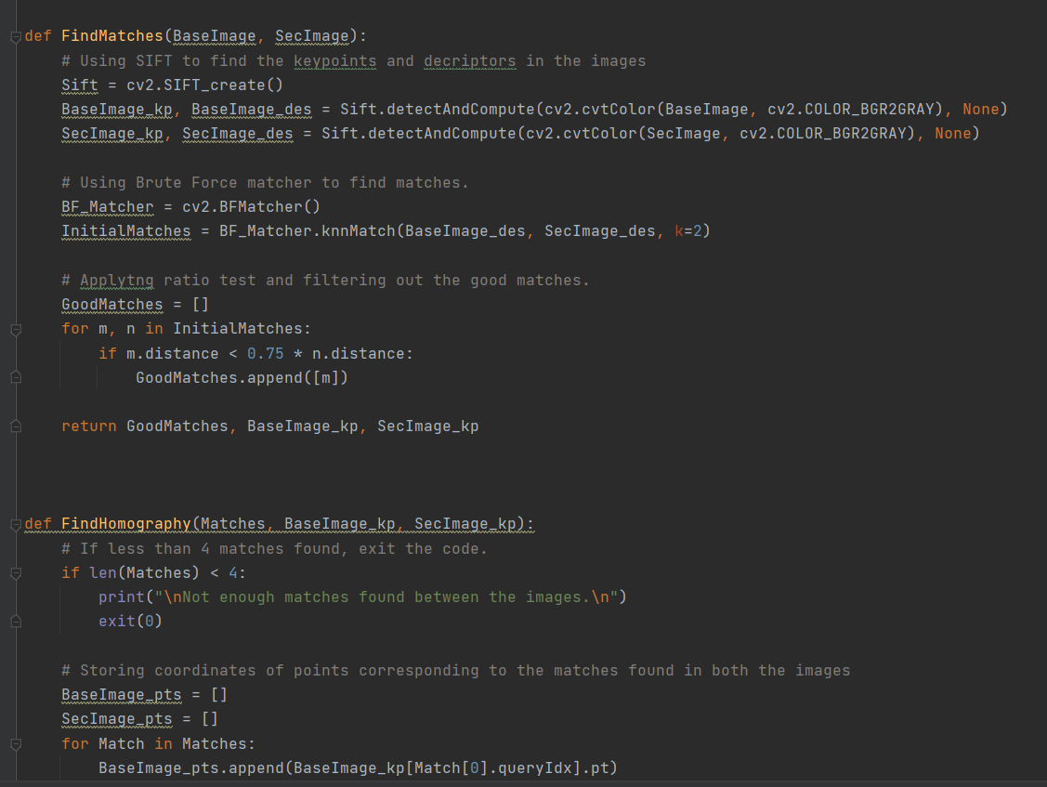
Cont..

Slide 24
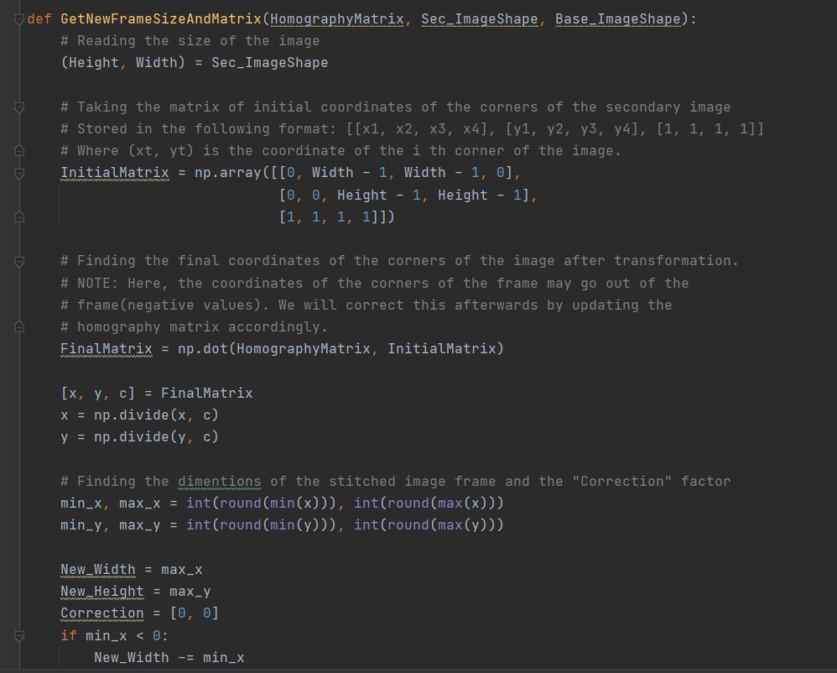
Cont..

Slide 25
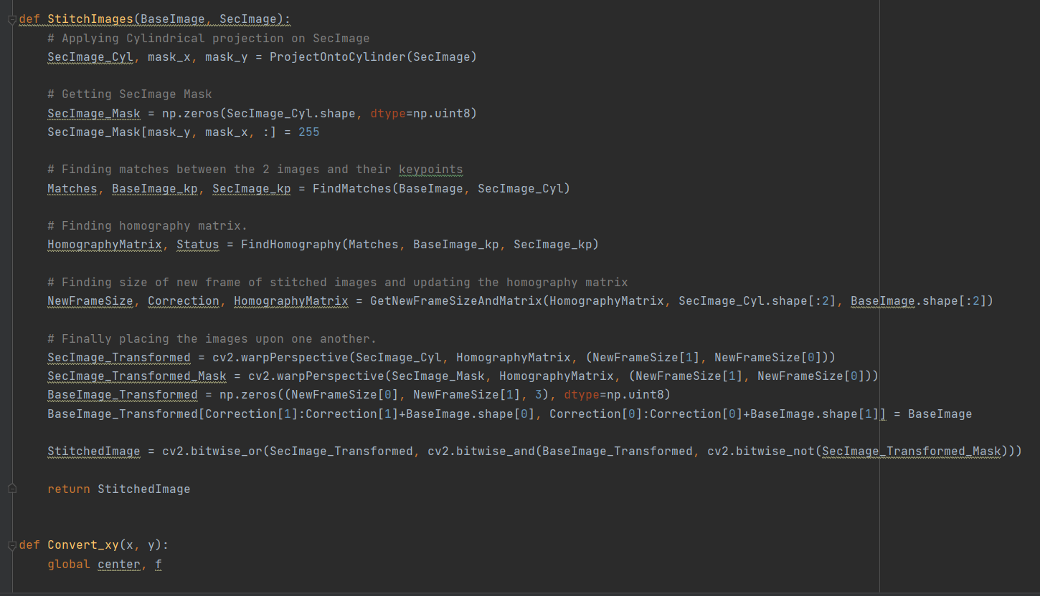
Cont..

Slide 26
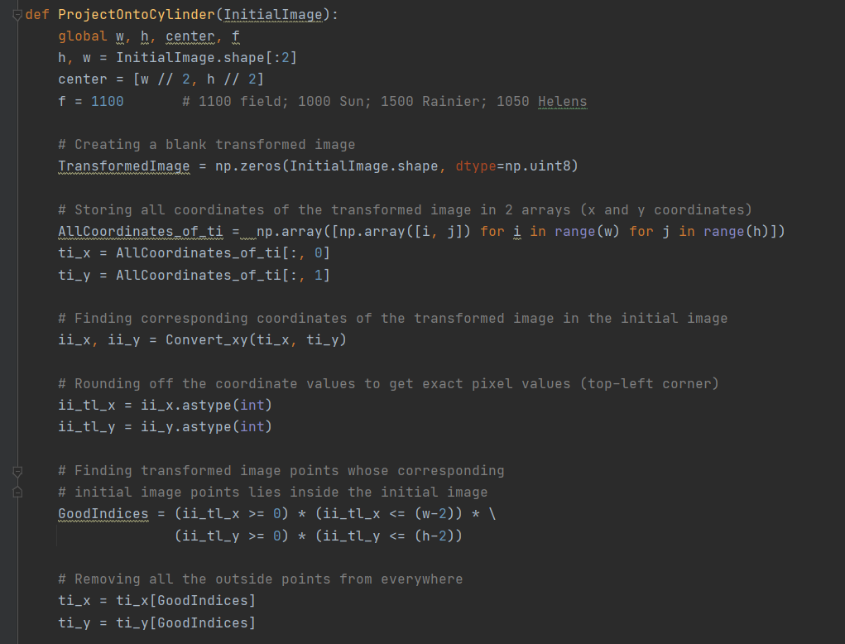
Cont..

Slide 27
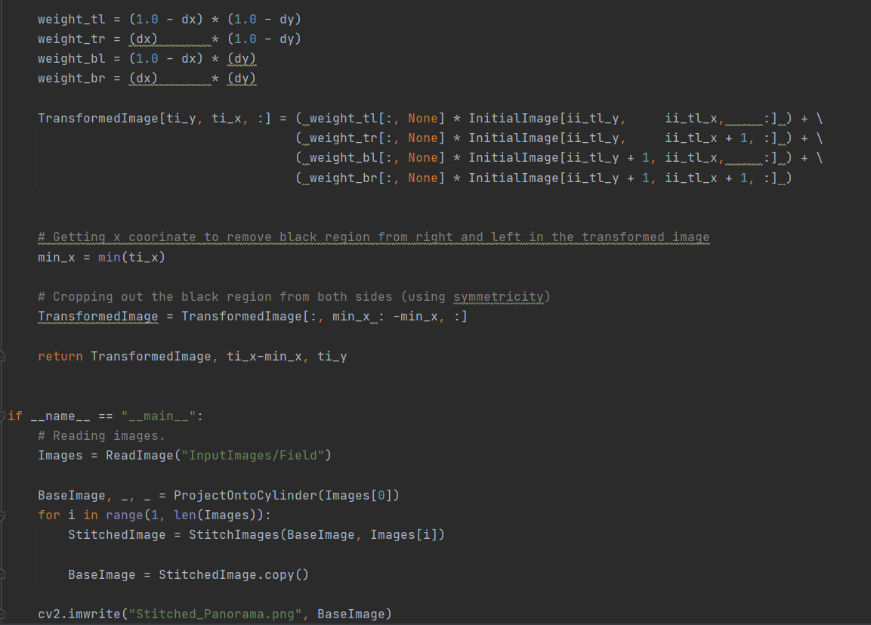
Cont..

Slide 28
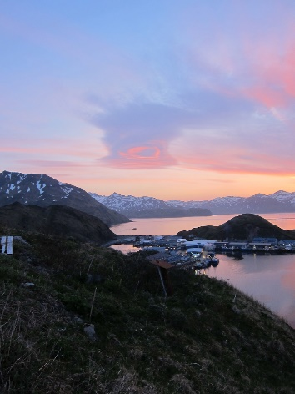
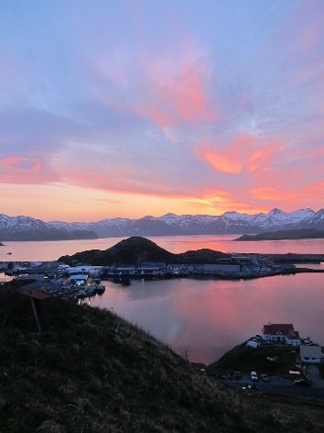
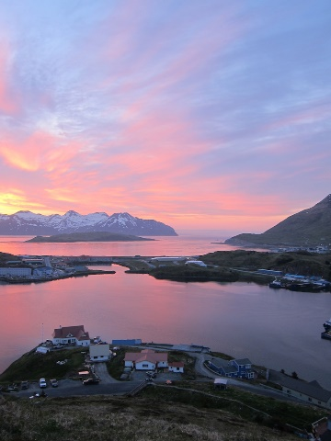
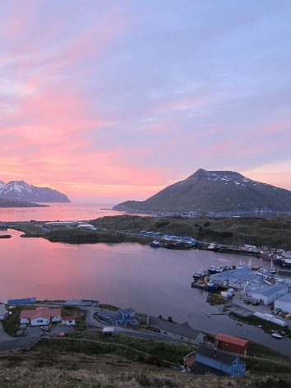
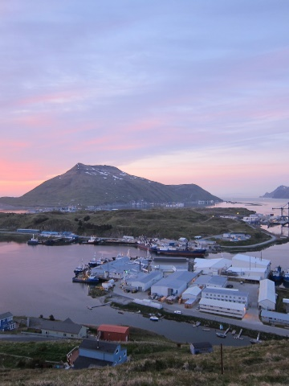
Cont.. Input images

Slide 29
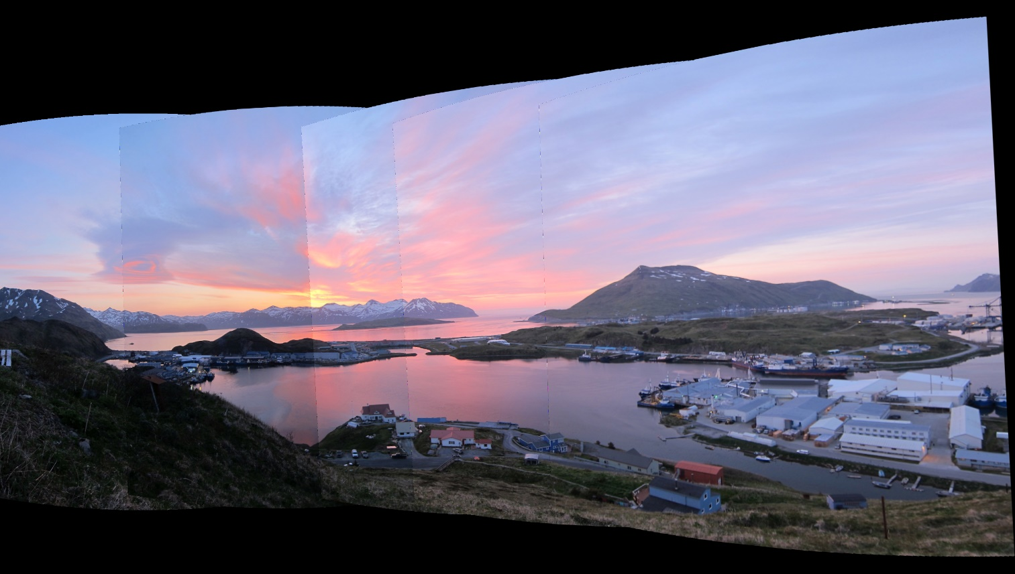
Cont.. Output image

Slide 30




Thanks and Acknowledgement
Thank you
30
30
Dr. Ahmed A. Elngar (Ph.D) Assistant Professor Faculty of Computers & Artificial Intelligence
Beni-Suef University, Beni Suef City, office box # (62511),, Egypt
Founder and Chair of the Scientific Innovation Research Group (SIRG)
Managing Editor in Journal of CyberSecurity and Information Management (JCIM)
Email: elngar_7@yahoo.co.uk
Email: ahmedelnagar@fcis.bsu.edu.eg Mobile : (+2)01007400752
www.sirg.club

